Slide 1
Rating & Review
https://www.youtube.com/watch?v=8v-mJWFFYbI&list=PLLUtELdNs2ZaZr4La5f0g3R6ljvwGkFrr&index=2&ab_channel=StackDevelopers

Slide 2
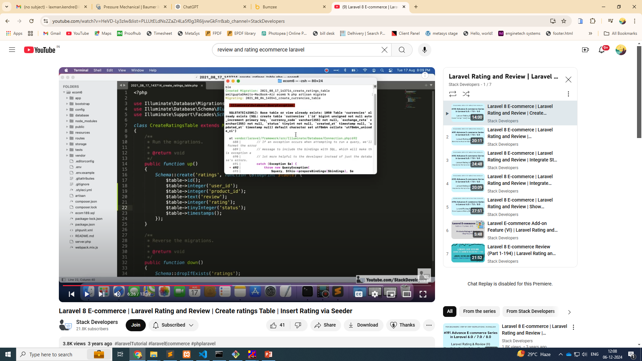
php artisan make:migration create_ratings_table

Slide 3
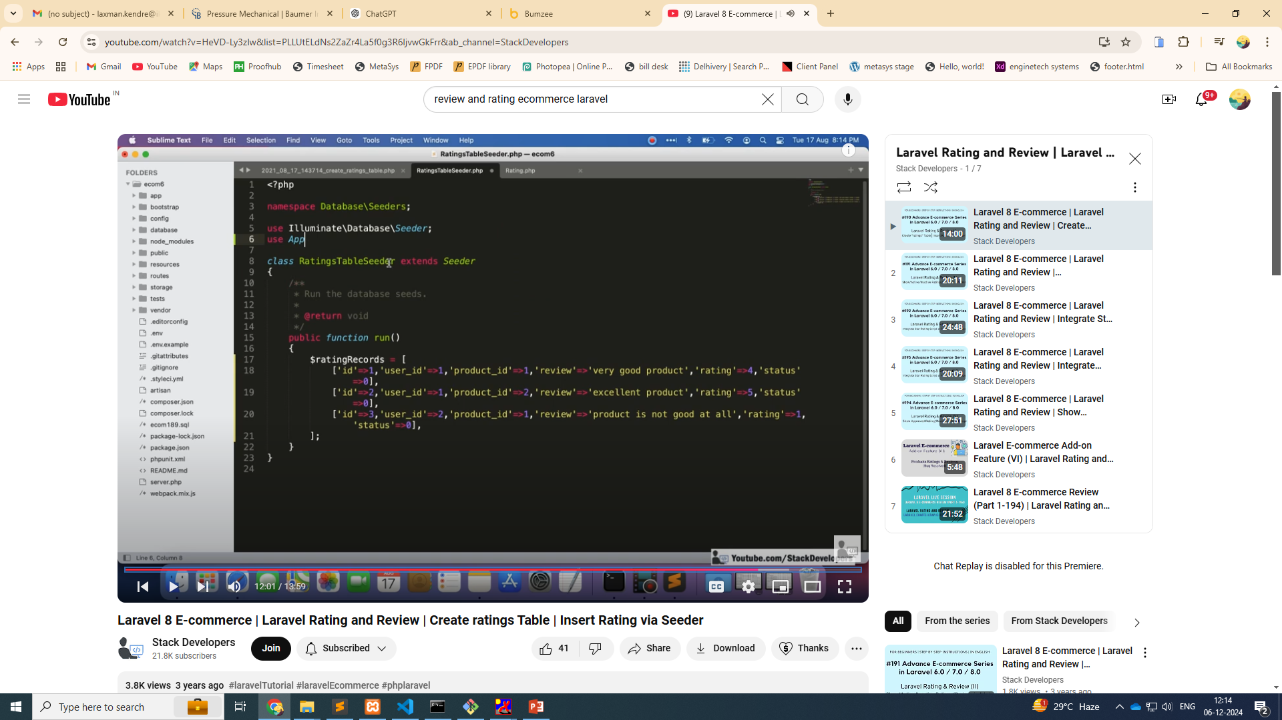
Php artisan make:seed

Slide 4
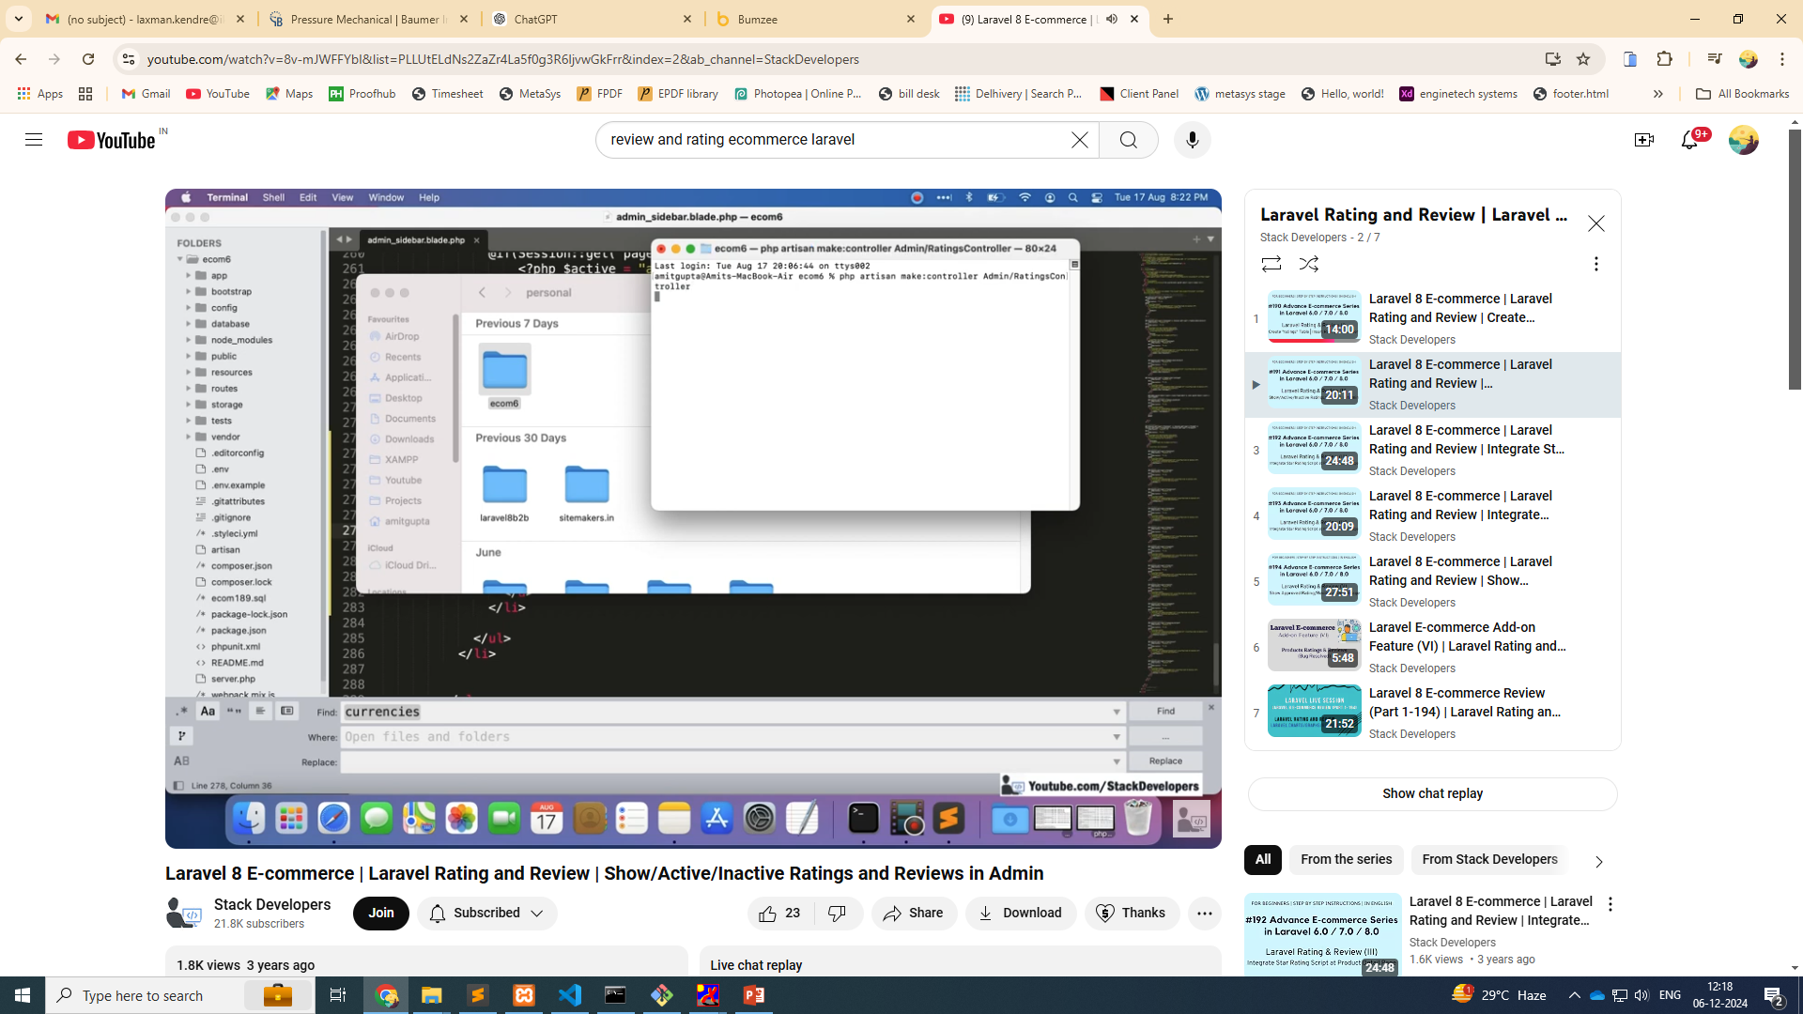
Admin controller

Slide 5
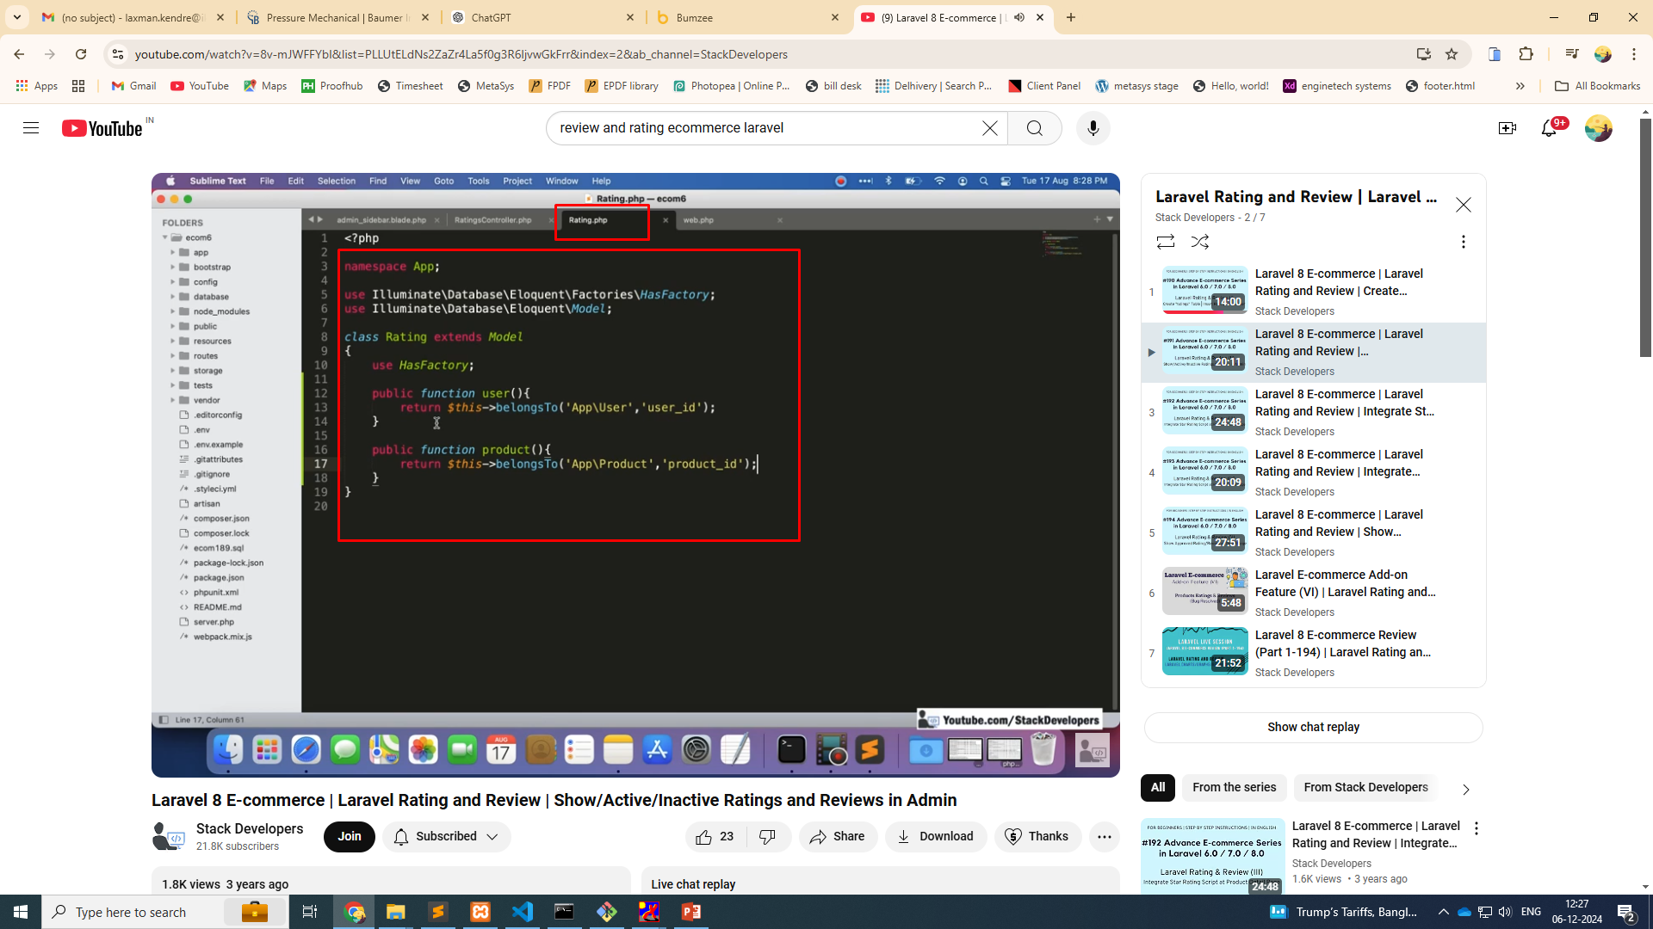
Model relationship

Slide 6
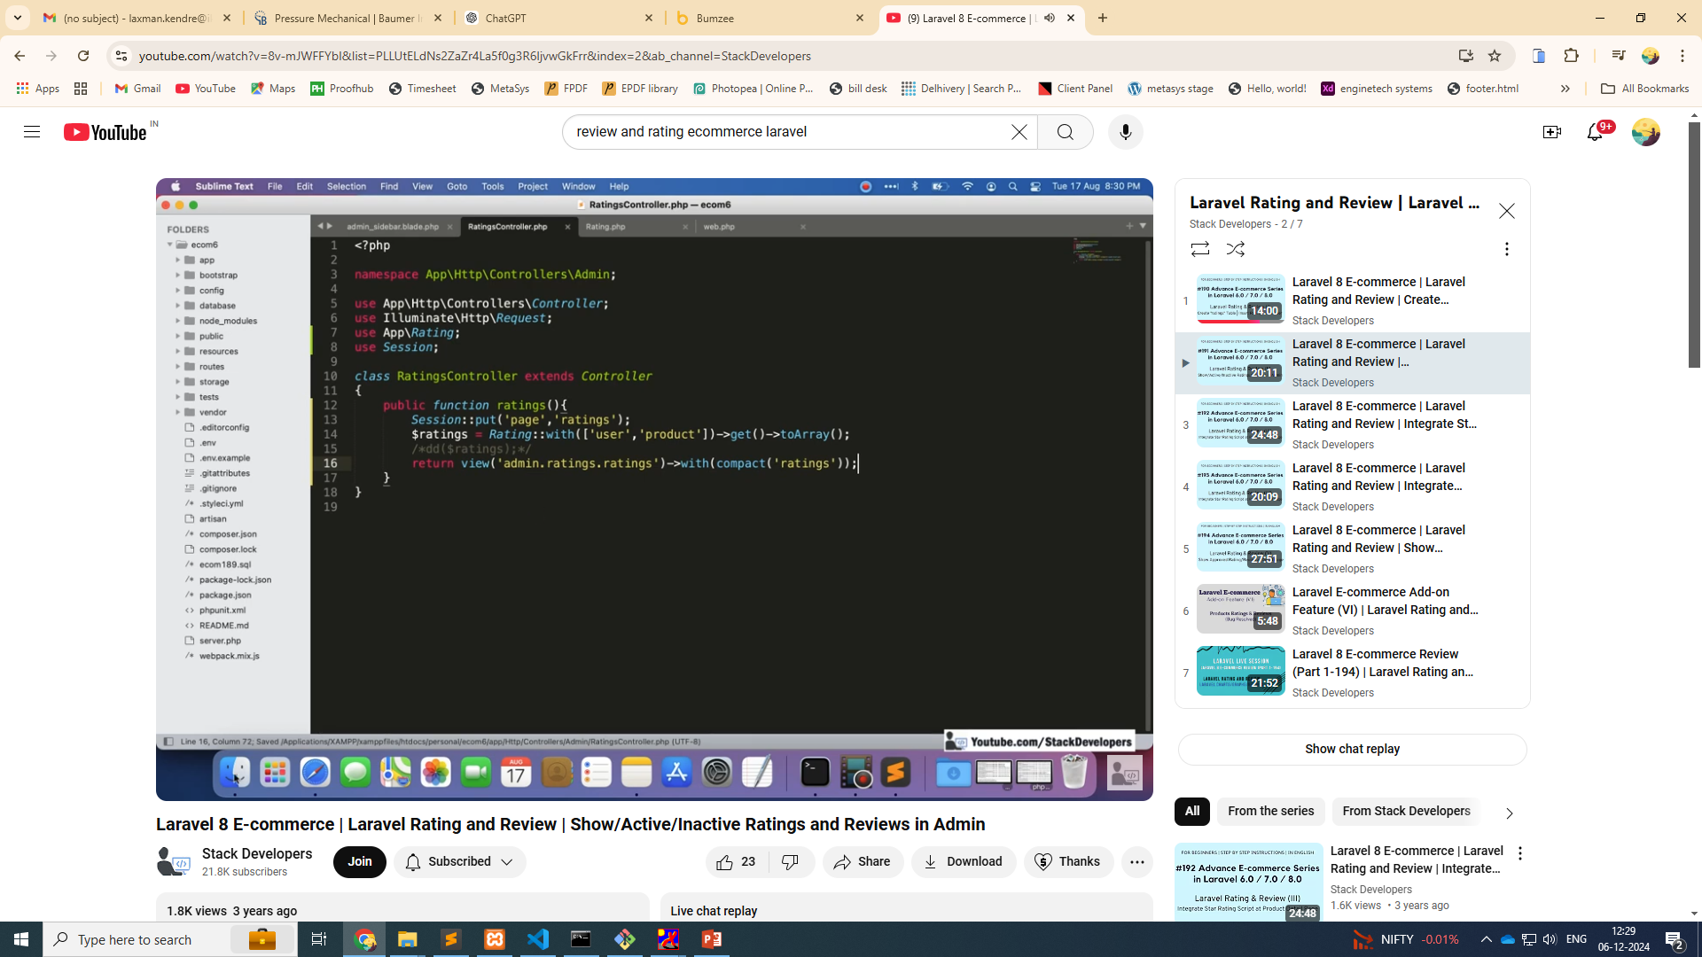
Admin controller

Slide 7
